Slide 2
Percent Low-Income by School District
Source: The Governor’s Office of Student Achievement, State Report Cards, % Eligible for Free/ Reduced Meals 2018

Slide 3
Percent Low-Income and Proficient + Distinguished 3rd Grade English Language Arts
Source: The Governor’s Office of Student Achievement, State Report Cards. Georgia Milestones 2018

Slide 4
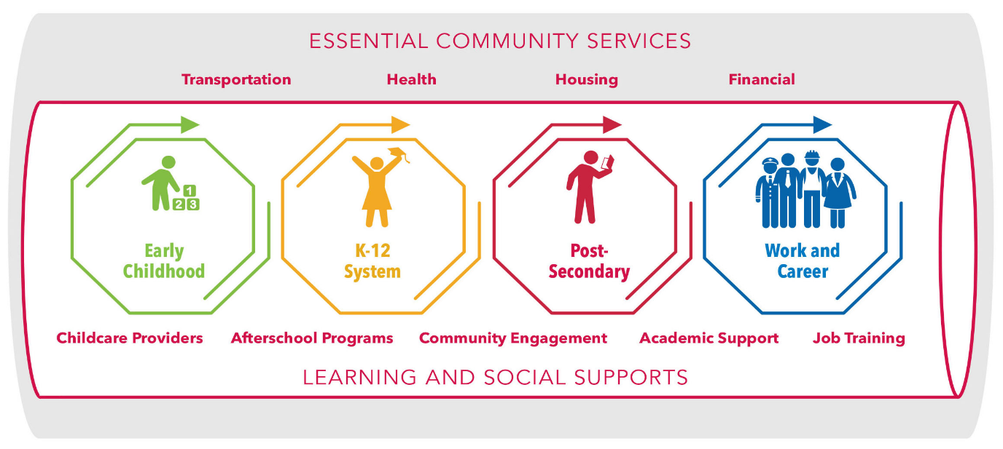
Economic Lifecycles
HOW DO WE MAINTAIN THE PIPELINE?
INSULATE THE PIPELINE!

Slide 5
Aligning Educational Strategies for
Collective Impact
Random Acts of Improvement
GOALS
Partially Aligned Acts of Improvement
GOALS
Aligned Acts of Improvement
GOALS

Slide 6
Connect with us
Twitter: @GAPartnership
Facebook: Georgia Partnership for Excellence in Education
Instagram: @GAPARTNERSHIP
LinkedIn: Georgia Partnership for Excellence in Education
Website: www.gpee.org

