Slide 1


SPONSORED BY:

Slide 2

Notes:
Look at the importance of a strong education pipeline as an economic development strategy

Slide 3
Education and Workforce Pipeline
Regional Summit – Brunswick
October 9, 2018
Examine the Data for Education in Georgia Economic Impact of Georgia Non-Graduates Strengthening the Birth to Work Pipeline What Can We Do?
Notes:
Look at the importance of a strong education pipeline as an economic development strategy..
Present some new data about the relationship between education and the workforce, some of which you already know, and some of it may be new to you.
Challenge you all to think about this relationship at several levels –the individual, the community and the state and think about where we are and where do we want to go –across all 3.
Finally, what is your role in moving the needle on education outcomes for students and the economic competitiveness of our local communities, businesses, and the state.

Slide 4
Examine the Data for Education in Georgia

Slide 5
Academic Achievement Milestones
School Readiness
Literacy by 3rd Grade
Numeracy by 8th Grade
High School Graduation
Workforce and/or College Ready
Notes:
This slide will be used as data organizer – begin with something like “The data we are about to see is the foundation for moving a child from early learning to a successful college/ career pathway…”
As we move through the presentation, we will talk about major milestones that lead to academic achievement…
School readiness
Literacy by 3rd grade
Numeracy by 8th grade
High School Graduation
Learn4Life - Metro Atlanta Regional Education Partnership is using these milestones to track and improve education outcomes for the Atlanta region.
Research says we can’t wait until the end of the pipeline, we must address each of these milestones along the way.

Slide 6
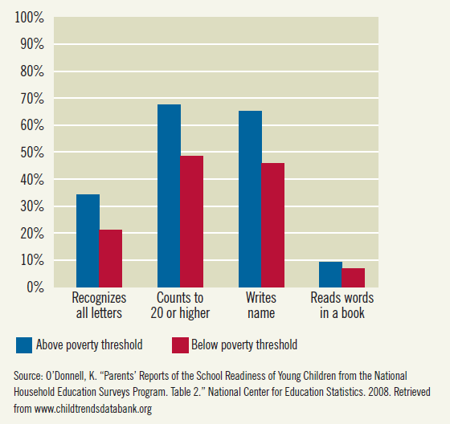
School Readiness
Percent of Children with School Readiness Skills
Notes:
National snapshot that illustrates how poverty effects school readiness
On average, when kids enter kindergarten . On average, lower income children start kindergarten already behind. The achievement gap is there before school even starts.
Later on we will see how this gap plays out as children age and move through the pipeline, thus highlighting the importance of early learning.

Slide 7
NAEP 4th Grade Reading
Percent At or Above Proficient
Notes:
This is proficient and advanced
NAEP score cut offs are: below basic, basic, proficient, advanced
Proficient is the level that is aligned with other college/ career ready standards: Common Core, ACT, Sat, etc.
NAEP is given to a sample of students administered every other year. It is currently the only assessment that allows state to state comparison.
2017 - 20th state is Idaho. Georgia is 32nd.

Slide 8
NAEP 8th Grade Math
Percent At or Above Proficient
Notes:
This is proficient and advanced
NAEP score cut offs are: below basic, basic, proficient, advanced
Proficient is the level that is aligned with other college/ career ready standards: Common Core, ACT, Sat, etc.
NAEP is given to a sample of students administered every other year. It is currently the only assessment that allows state to state comparison.
2017 - 20th state is Connecticut. Georgia is 31st.

Slide 9
Georgia High School Graduation Rates
Year | High School Graduation Rate State Average
2014 | 73%
2015 | 79%
2016 | 79%
2017 | 81%
2018 | 82%
Source: Governor’s Office of Student Achievement (2014-17), Georgia Department of Education (2018)
Notes:
4 year cohort graduation rate (does NOT include special ed diplomas)
This chart shows the high school graduation rate. It is the new calculation method and shows the number of kids who started the 9th grade and finished the 12th grad on time.
In 2017, we had over 20,000 young adults who dropped out of HS, and probably are not prepared to be the best parent they could be.
What is the graduation rate for your school district? Have they been showing improvement over the last several years? If so, give them some positive feedback! If not, ask what you can do to help improve that pipeline.
Slide Transition: question – I get asked – Are these 81% ready for work/ college?

Slide 10
Percent of ACT Tested High School Graduates Meeting College Readiness Benchmarks - Reading
Source: ACT, National -- The Condition of College and Career Readiness 2017

Slide 11
Percent of ACT Tested High School Graduates Meeting College Readiness Benchmarks - Math
Source: ACT, National -- The Condition of College and Career Readiness 2017

Slide 12
Economic Impact of Georgia Non-Graduates

Slide 13
Education Pays
EDUCATIONAL ATTAINMENT & EMPLOYMENT
Unemployment % Rate* |  |  |  |  |  |  |  | July 2018 | Approx. Annual Earnings**
 |  |  |  |  |  |  | 2.2% | Bachelor’s Degree & Higher | $66,456
 |  |  |  |  |  | 3.2% |  | Some college/ Associate Degree | $41,600
 |  |  | 4.0% |  |  |  |  | HS Graduates, No College | $37,128
 | 5.1% |  |  |  |  |  |  | Less than a High School Diploma | $27,612
Source: *U.S. Bureau of Labor Statistics Table A-4. Employment status of the civilian population 25 years and over by educational attainment.
**U.S. Bureau of Labor Statistics Table 5. Quartiles of usual weekly earnings of full-time wage and salary workers, approximation based on median earnings.
Notes:
This comparison of the impact of education on income and unemployment rates, shows less education means higher unemployment rates and lower average earnings.
When you look at the income for a person with less than a high school diploma compared with income for a person who completes high school and even some college, it adds up to over ½ million dollars over a life time.
What does this mean for a person in terms of ability to own a car or a home?
For your community, what does it mean in terms of a person incurring debt; then if out of work and can’t pay their debt? They often start a downward, spiraling experience that hurts them, their family and sometimes even their community.
Also, for those without a high school diploma, employment is not only at a lower rate and lower salary, but also tends to be more cyclical.

Slide 14
Compounded Impacts of
High School Non-Completion
INDIVIDUALS |  | THE COMMUNITY
Lower Lifetime Earnings |  | Reduced buying power & tax revenues; less economic growth
Decreased health status; Higher mortality rates; More criminal activity |  | Higher health care & criminal justice costs
Higher teen pregnancy rates; Single motherhood |  | Higher public services costs
Less voting; Less volunteering |  | Low rate of community involvement
Source: Levin, H., et al., (2007). The Costs and Benefits of an Excellent Education for All of America’s Children.
Notes:
Roll those dollars up and what happens to the individual and to the community.
Lower Lifetime Earnings – can mean a difference of ½ million dollars or more for the individual
Reduced Buying Power – businesses are concerned about this. Think of what it could also man in reduced tax revenues. School systems use the SPLOST to renovate and build schools
Decreased Health Status…-- Raises many health issues
Higher Health Care…-80% of folks in prison don’t have a HS diploma; contributes to increased cost
Higher Teen Pregnancy Rates…- How many 15 – 19 year olds in your community have their 1st baby or even their 2nd baby? Realizing that a mother is a child’s first teacher, they are not always the best teacher, especially when a young teenage mother. Again, you will see some of those numbers in the KidsCount data we will share
Higher Public Service Costs –
Less Voting and Volunteering –
Less Community Involvement – This impacts the infrastructure of a community
Community involvement- for economic development – need community engagement and civic involvement.
Transition to next slide – so we see what this looks like for an individual and how that translates to impacts on a community. Next, I want to look at the economic impact (dollar amount) on the state.

Slide 15
Economic Impacts – The Graduation Effect
If Georgia’s Graduation Rate increased to 90%
Within 10 years – a new graduate who completes at least an associate’s degree will earn, on average, $15,600 more a year than a hs dropout.
$160 million in additional income
$10.5 million in state and local tax revenue
$600 million on health-care cost savings
Percent with public health insurance or no health insurance in 2015:
71% hs dropout
45% hs graduate
$260 million in home sales
Source: Alliance for Excellent Education’s “The Graduation Effect” with support from State Farm; http//impact.all4ed.org/
Notes:
Be clear about the 90% graduation rate – based on 2015 graduation rate of 78.8%
Just a few examples, more in the Econ of Ed publication page 13

Slide 16
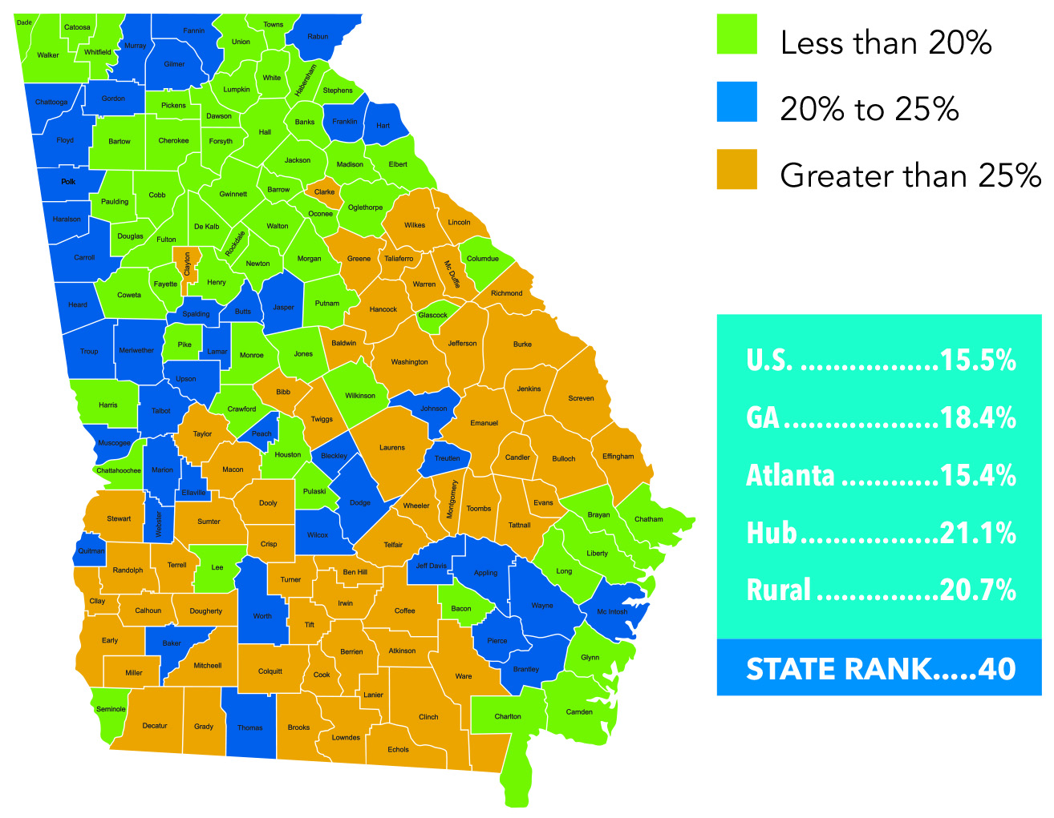
Barriers to Economic Growth: Poverty Rates
ACS 2015 5-year estimates/Kids Counts Data Center
Notes:
Calculations done by the Georgia Chamber of Commerce
Adult population
59 of Georgia’s 159 counties have greater than 25% poverty
Lowest Poverty Rate – Forsyth and Oconee (7%)
Highest Poverty Rate – Calhoun and Clay – 42% of the residents are below the official poverty threshold

Slide 17
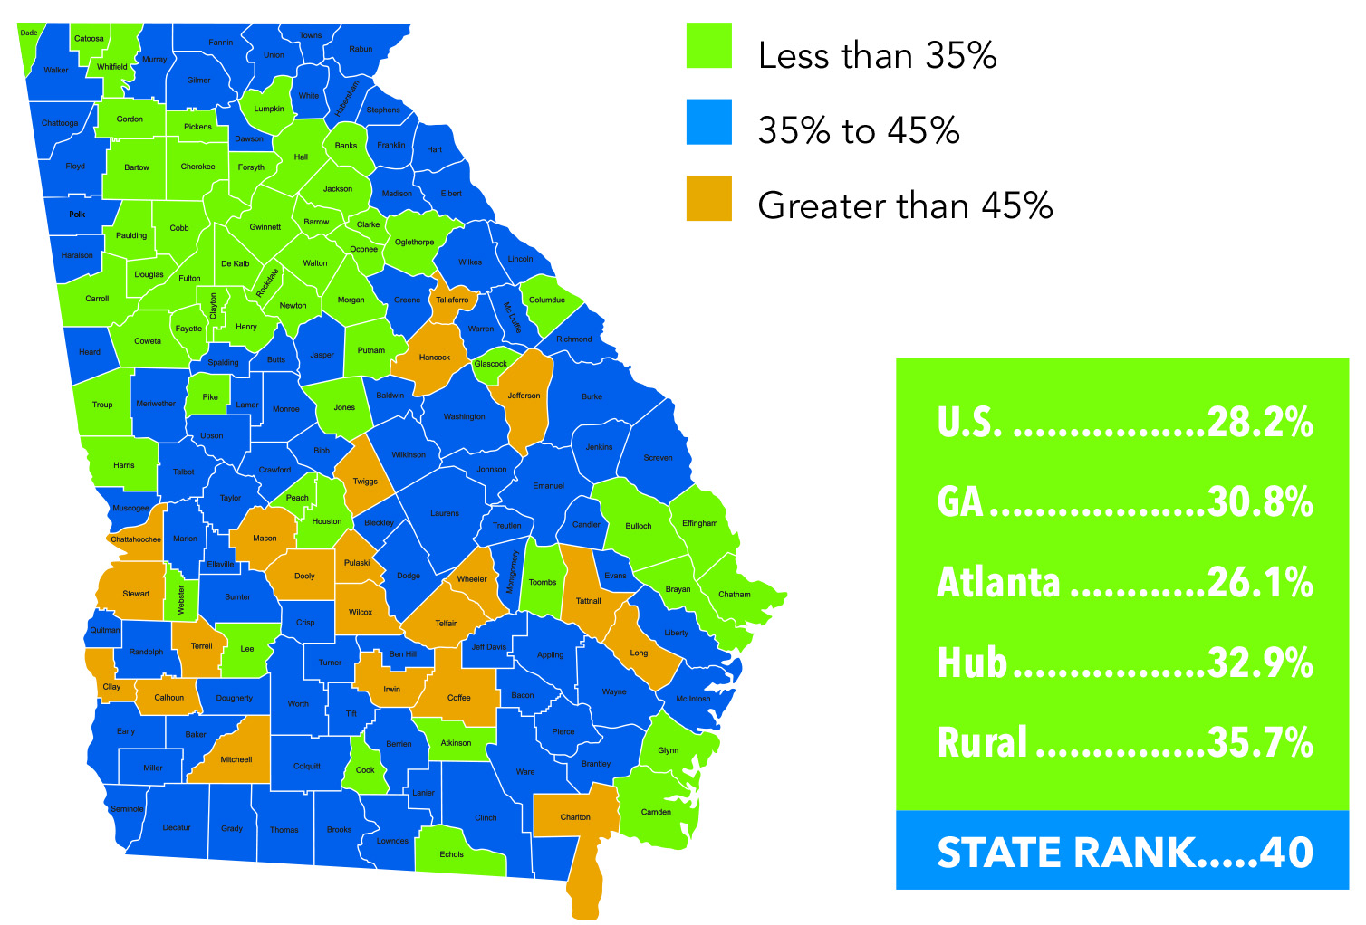
Barriers to Economic Growth:
Adults Not Working, Ages 25-64
Compiled by Georgia Chamber of Commerce 2030, ACS 2015 5-Year estimates
Notes:
Challenge for communities – how to do you re-enegage the adult population in the workforce. Why are they out of it? Job training? Literacy? Education levels?

Slide 18
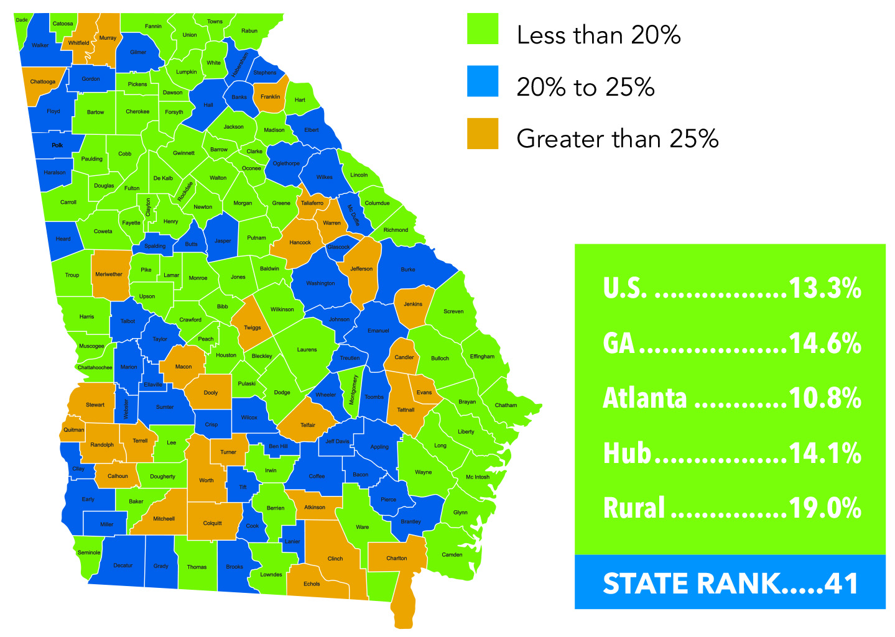
Barriers to Economic Growth:
Adults Without A High School Diploma
Compiled by Georgia Chamber of Commerce 2030, ACS 2015 5-Year estimates

Slide 19
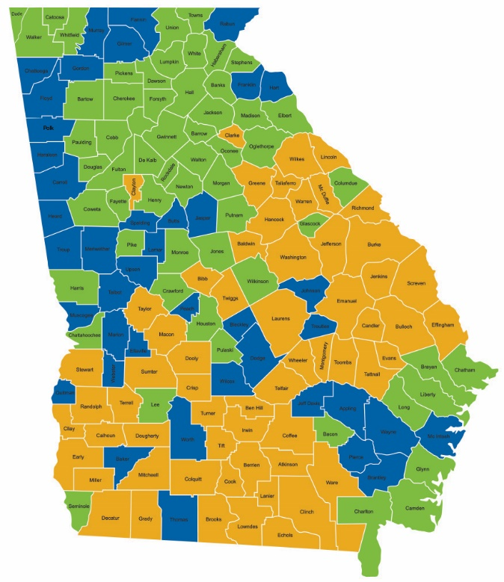
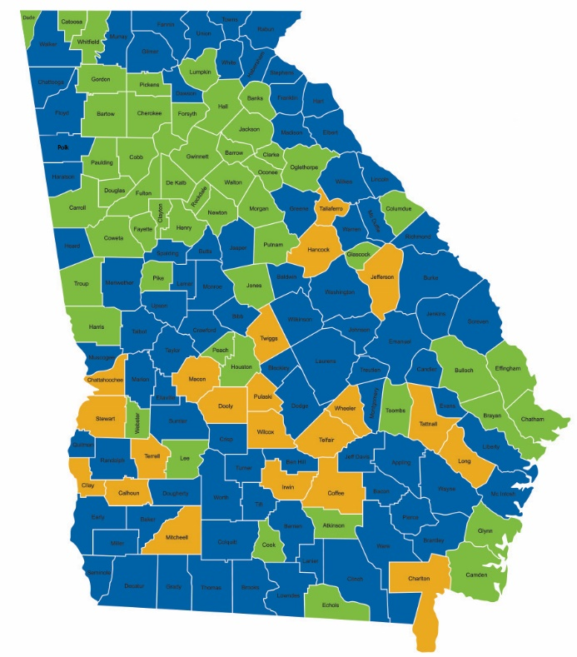
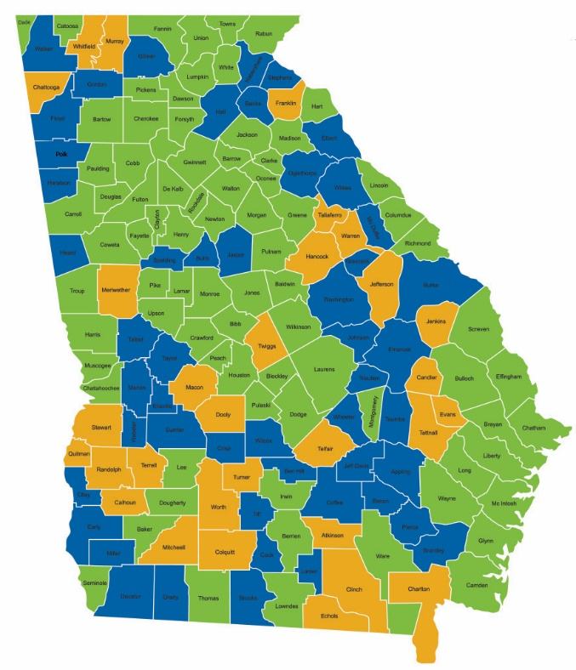
Barriers to Economic Growth
Poverty
Adults Not Working
No HS Diploma
Notes:
Doug Betchel – UGA professor – started with the 2 Georgia’s. Before he passed away, he updated that to the 5 Georgia’s: Urban, Urbanizing, Suburban, Rural Growth, Rural Decline
Rest of the state is important. Statewide agencies, statewide presence. Also, Atlanta can’t continue to support the rest of the state.

Slide 20
Strengthening the Birth to Work Pipeline
Notes:
Slide transition statement – Now we have looked at the impact of hs graduation/ non graduation, it’s potential and some of the barriers we are facing. So, how do we overcome the barriers and reach the potential?

Slide 21
Strengthening the Birth to Work Pipeline
Notes:
Start with the foundations -

Slide 22
Disparities in Early Vocabulary Growth
Professional Families 1,116 words
Working Class Families 749 words
Welfare Families 525 words
Source: Hart, B. and Risley, T. R. (2003). “The Early Catastrophe: The 30 Million Word Gap by Age 3.”
Notes:
Called the Early Catastrophe Slide – language development is one of the foundations of successful learning and we see the gaps early. By 3 year old, very pronounced.

Slide 23


Essential Elements of
High Performing States
Foundations for Learning
Quality Teaching
Quality Leadership
Supportive Learning Environments
Advanced Instructional System
Clear Pathways to Postsecondary Success
Adequate and Equitable Funding
Notes:
EdQuest set –up
Steve mentioned before – you have the handouts. Summary of opportunities and breakouts for each section.

Slide 24
The Changing Face of Georgia
Source: U.S Census Data
Notes:
Issue #2 for trifecta/perfect storm slide. Where our population is growing…
“living in poverty” are those living below the poverty line.
Concerning – jump in % of poor students.
2006 – 24%
- 62%
Hispanic/ Asian populations – not a problem, but challenge for our school systems in increasing % of ELLs.
Next slide is graduation rates of our fastest growing populations…

Slide 25
Achievement Gaps
 | 4th Grade Reading*
All Students | 35%
Low-Income | 25%
English Language Learners | 10%
8th Grade Math*
31%
20%
4%
HS Graduation**
82%
77%
58%
*Source: National Assessment of Educational Progress, 2017 Percent of students proficient and above
**Source: Georgia Department of Education, 2018 High School Graduation Rate
Notes:
Disconnect – need the foundation to make sure ALL kids are reading on grade level.
Can’t do business as usual – we will fail.

Slide 26

The Missing 57%
100 Georgia 9th Graders Enter High School!
81 graduate HS
62 enroll in higher education
43 make it to their sophomore year
Source: Ga DOE data for 2016-2017 school year; projections by Atlanta Regional Commission
Notes:
Source: Ga DOE 2012-2013 school year, calculations by Atlanta Regional Commission estimates

Slide 27
Georgia’s Economic Development Needs
Replacement
1,151,228
TOP GROWING INDUSTRY SECTORS
2015-2025 PROJECTIONS
4,956,144
Georgia is experiencing a talent gap. This talent gap is a mismatch between degrees and skills needed by employers versus the degrees and skills of the population.
Source: Compiled by Georgia Chamber of Commerce 2030, JobsEQ Analysis

Slide 28
Georgia Needs:
The Economic Development Pipeline
60% of jobs in 2020 will require some higher education
48% of Georgians currently have a post-secondary degree
Goal:
250,000 new graduates by 2025
Source: Complete College Georgia, https://completega.org/
Notes:
We do not currently have the workforce necessary to support our economic development needs to allow Georgia to be economically competitive – not only with other states, but internationally as well.
The 250,000 is a target set by the Complete College Georgia Plan out of the Governor’s office.

Slide 29
Georgia’s Future Workforce
1. Increasing academic rigor and expectations
+
2. Changing demographics
+
3. Increasing demand for highly skilled labor force
=
Positive Collective
Impact?
Perfect Storm?

Slide 30
What Can We Do?

Slide 31
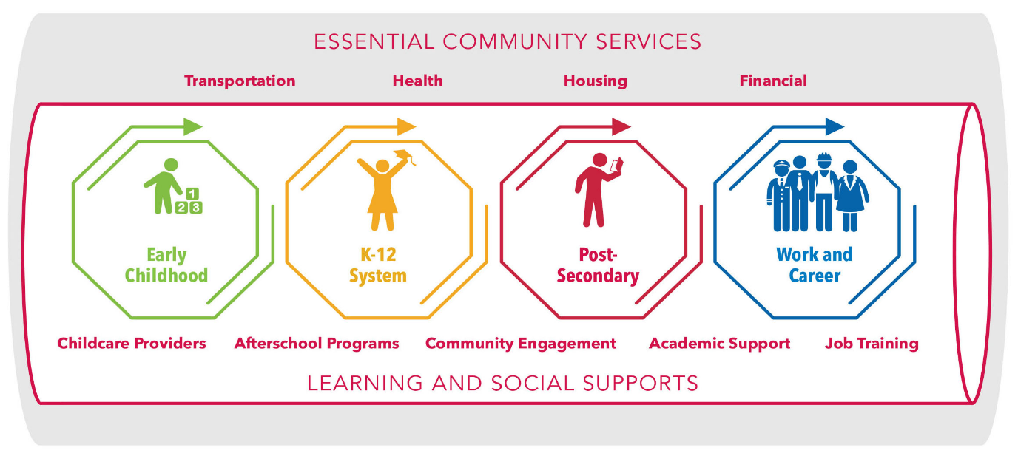
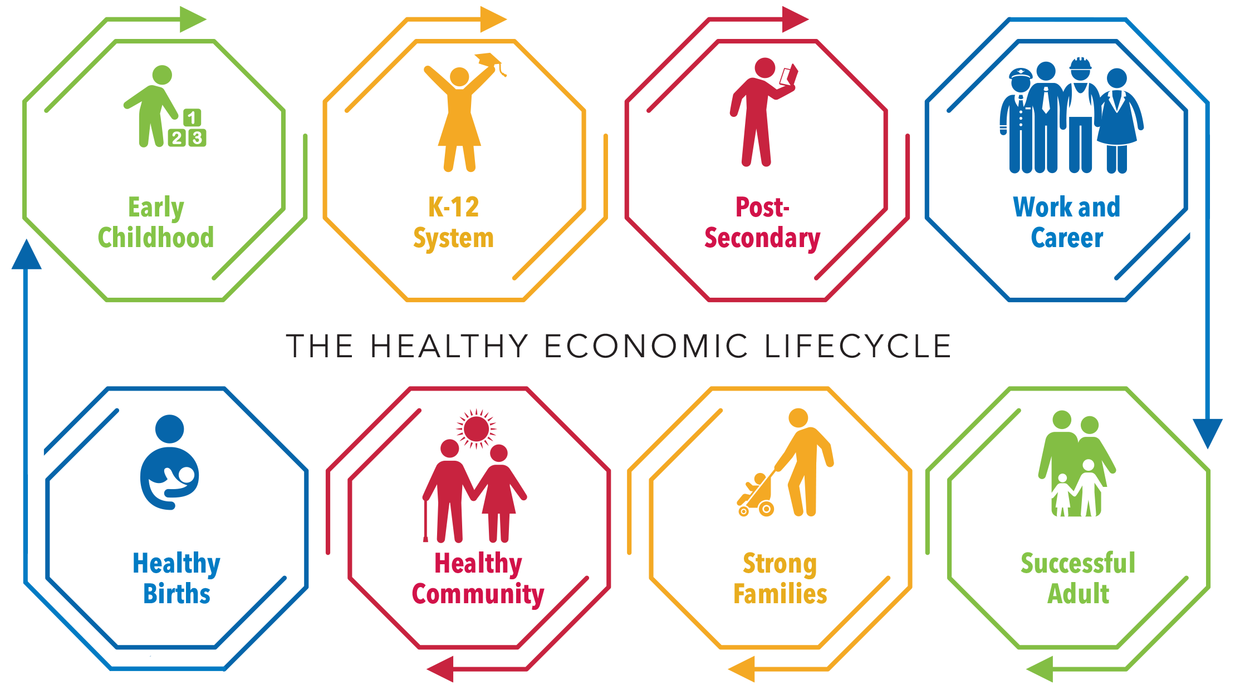

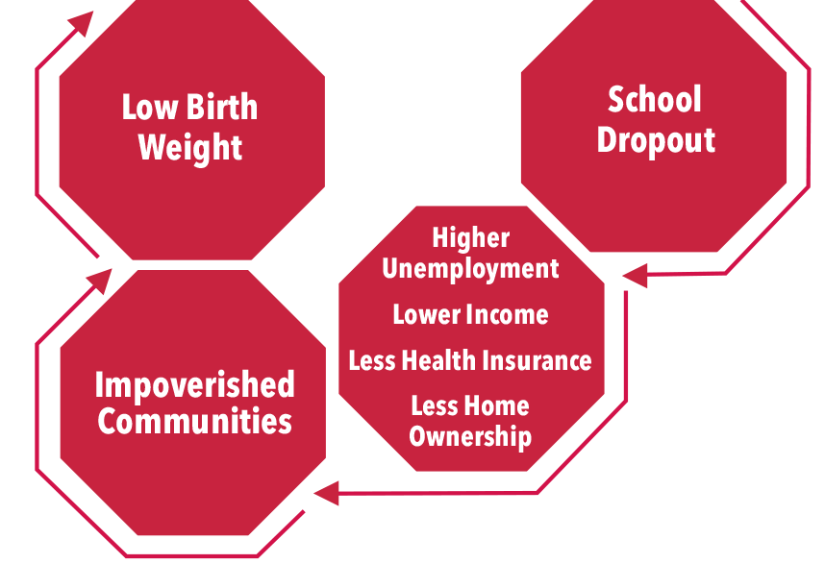
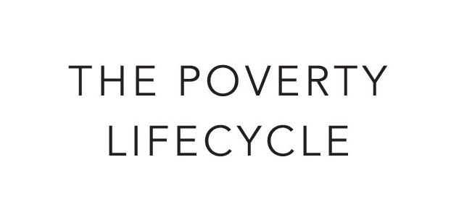
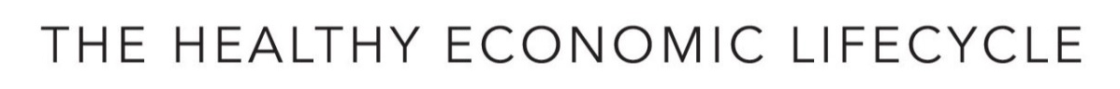


Economic Lifecycles
HOW DO WE MAINTAIN THE PIPELINE?
INSULATE THE PIPELINE!

Slide 32
Profile of Child Wellbeing and Academic Achievement
Source: Georgia Kids Count, Georgia Family Connection Partnership, http://www.gafcp.org

Slide 33
Teen Birth Rates Per 1,000
Source: Georgia Kids Count, Georgia Family Connection Partnership, http://www.gafcp.org

Slide 34
Percent Teens Not Working or in School
Source: Georgia Kids Count, Georgia Family Connection Partnership, http://www.gafcp.org

Slide 35
Percent Low-Income by School District
Source: The Governor’s Office of Student Achievement, State Report Cards 2017

Slide 36
Percent Low-Income and
Proficient + Distinguished 3rd Grade Language Arts
Source: The Governor’s Office of Student Achievement, State Report Cards. Georgia Milestones 2017

Slide 37
Percent Low-Income and
Proficient + Distinguished 8th Grade Math
Source: The Governor’s Office of Student Achievement, State Report Cards. Georgia Milestones 2017

Slide 38
Percent Low-Income and HS Graduation
Source: Georgia Department of Education, High School Graduation Rates 2018

Slide 39
Help Insulate the Pipeline
Early Childhood
Read to children every day: “Talk with Me Baby”
Encourage participation of your early learning centers: “Quality Rated”
K – 12 System
Support “Get Georgia Reading Campaign”
Leverage partnerships with business and post-secondary – internships and mentoring
Consider dual enrollment high school/college
Post Secondary
Provide internships/ apprenticeships
Participate and support: “Go Back. Move Ahead.”
Promote adult literacy efforts
Notes:
39
Talk w/ Me Baby – remember the Early Catastrophe slide and the 30 million word gap. This can help overcome that gap.
College access talking point – GPEE has a grant from Board of Regents to Coweta County to reach out to their college drop outs and get them back into college to get a 2 or 4 year degree.
Adult population – thinking back to that 250,000 – not enough kids in the pipeline. How do we re-engage the adult population, esp those not working. Go-Back Move Ahead and adult literacy can help there.
Grow your own – especially in rural. Business & post-secondary partnerships can take many form….

Slide 40
Aligning Educational Strategies for
Collective Impact
Random Acts of Improvement
GOALS
Partially Aligned Acts of Improvement
GOALS
Aligned Acts of Improvement
GOALS
Notes:
If your efforts are not aligned, whether in business or schools, it’s going to be harder to stay focused and reach your goal. How many of your schools have random acts that compete against each other?
If we are all aimed in the same direction with focus on the same goal, it can be reached. In business, that goal is profits; in education, that goal is student achievement.
Slide transition statement – Now, we want to take some time for you all to reflect on how to align your acts of improvement around your goals.

Slide 41
Small Group Discussion

Slide 42
Essential Elements of
High Performing States
Foundations for Learning
Quality Teaching
Quality Leadership
Supportive Learning Environments
Advanced Instructional System
Clear Pathways to Postsecondary Success
Adequate and Equitable Funding
Notes:
EdQuest set –up
Steve mentioned before – you have the handouts. Summary of opportunities and breakouts for each section.

Slide 43
Questions to Consider:
Question #1 | Which areas are most relevant to your work and/or community?
Question#2 | Which one is the greatest priority?
Question #3 | Who else is/ should be working on this issue?
Notes:
Turn to your partner, folks sitting around you, and consider these 3 questions.
You have a sheet in your packet with these questions on them. We will be gathering them back up at the end so please write down your thoughts for us. As much as we are challenging you all to think about your next steps and the so-what, knowing your priorities, helps us (GPEE) to prioritize our work around these issues as well.

Slide 44
Essential Elements of
High Performing States
Foundations for Learning
Quality Teaching
Quality Leadership
Supportive Learning Environments
Advanced Instructional System
Clear Pathways to Postsecondary Success
Adequate and Equitable Funding
Notes:
During the report out –
Who would like to share?

Slide 45
We value your feedback
www.Tinyurl.com/BrunswickSummit

Slide 46

Connect with us
Twitter: @GAPartnership
Facebook: Georgia Partnership for Excellence in Education
Instagram: @GAPARTNERSHIP
LinkedIn: Georgia Partnership for Excellence in Education
Website: www.gpee.org
PROGRAM SPONSOR:

